Slide 1
FourOneSix Sound
Prepared by Romario Kevin Tulloch & Andrew Le

Slide 2
Abstract
The purpose of this project was to develop a piece of technology with a combination of software and hardware developed by us. We chose an amplifier as the hardware that we will be developing around and the software was an application we developed on the android platform to control the system as a whole using IOT working though a Firebase Database. This database will store all the account information and also the music files that each account uploads into the database. When commanded by the android application, the music files in the database will be downloaded and played through the audio amplifier and speakers. We feel that this is a great product as in the audio industry it is can be very useful in testing speaker installs and benchmarking audio quality.

Slide 3
Problem
The general problem that is faced in audio benchmarking currently is that during the testing process of speakers, it is important to make a note of how heavy a system can be pushed before it exceeds it limits in regards to distortion and clipping.

Slide 4
Solution
An app was developed by us which allows users to have their favorite songs stored in the database and be able to play it when they want through either the phone or the hardware.
Volume can be adjusted through the app to find the perfect level of sound, and the volume will also be saved to the database.
We used an Audio Amplifier as our hardware to work with a raspberry pi to create the speaker that connects to our app.

Slide 5
Budget
Raspberry Pi 3B+ & Casing - $100
TPA2016D2 - $22
Speakers - $20
3.5mm Headphone Jack Adapter - $7
Speaker Wires - $5
USB Extensions - $20
Wood For Enclosure - $15
Total: $189

Slide 6
Sensor – TPA2016D2
Part Number: 1712 (Adafruit)
Amplifier Class: Class D Efficiency (~90% Efficiency)
Power Stats: 2.8W Peak Stereo
Voltage: 2.7V – 5.5V

Slide 7
Android Application & Python Code
https://github.com/RomarioT/CENG355/tree/master/CENG355-master/FourOneSixPlayer-master
https://github.com/RomarioT/CENG355/blob/master/FourOneSix%20Sound.py

Slide 8
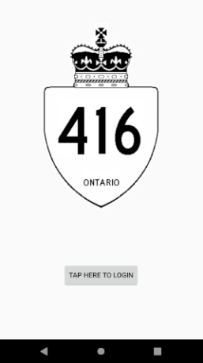
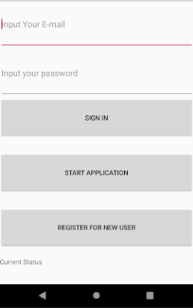
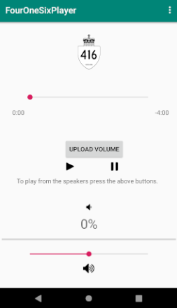
Android Application

Slide 9
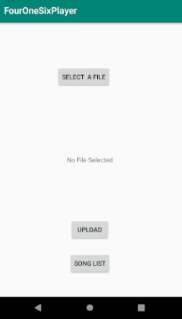
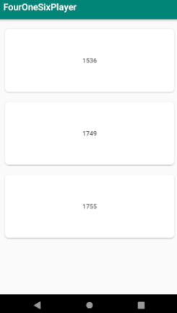
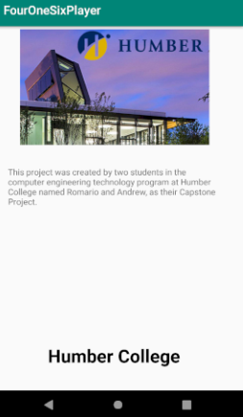
Android Application

Slide 10
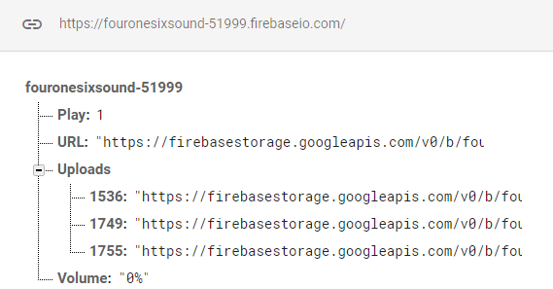
Firebase Database

Slide 11
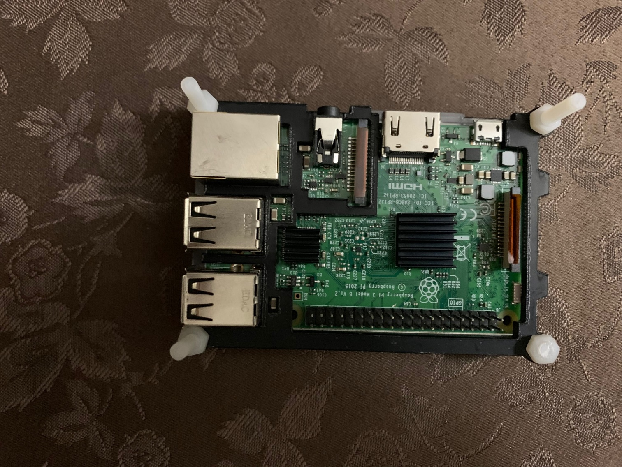
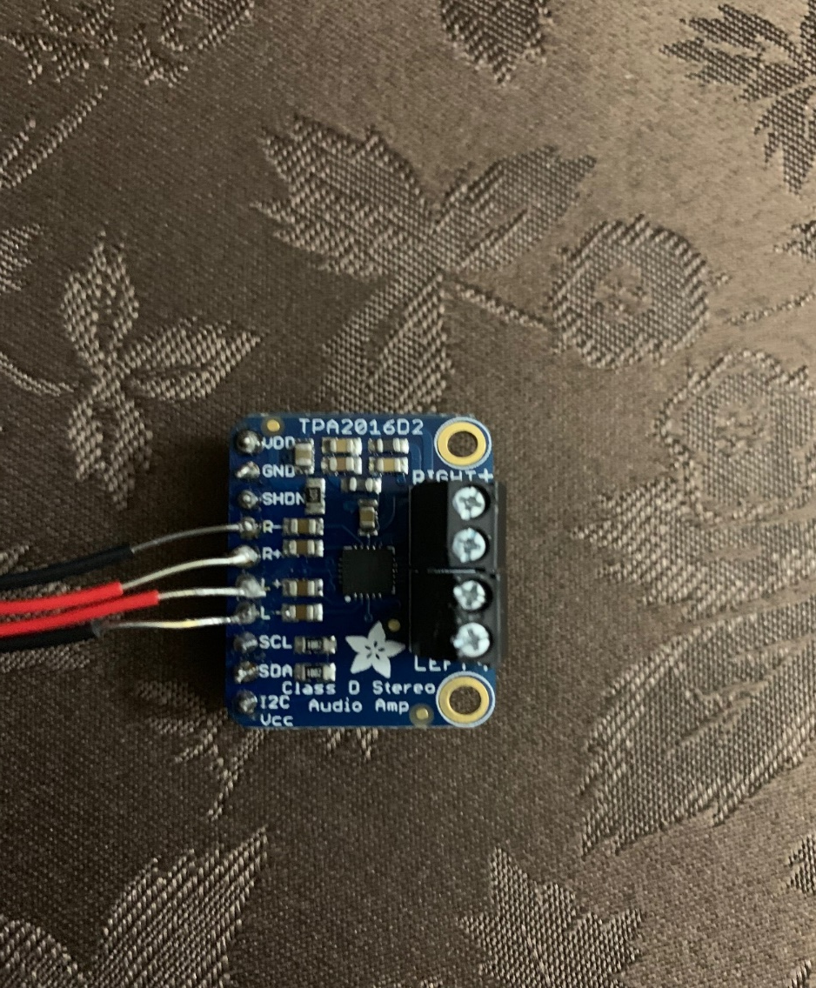
Raspberry Pi and Sensor

Slide 12
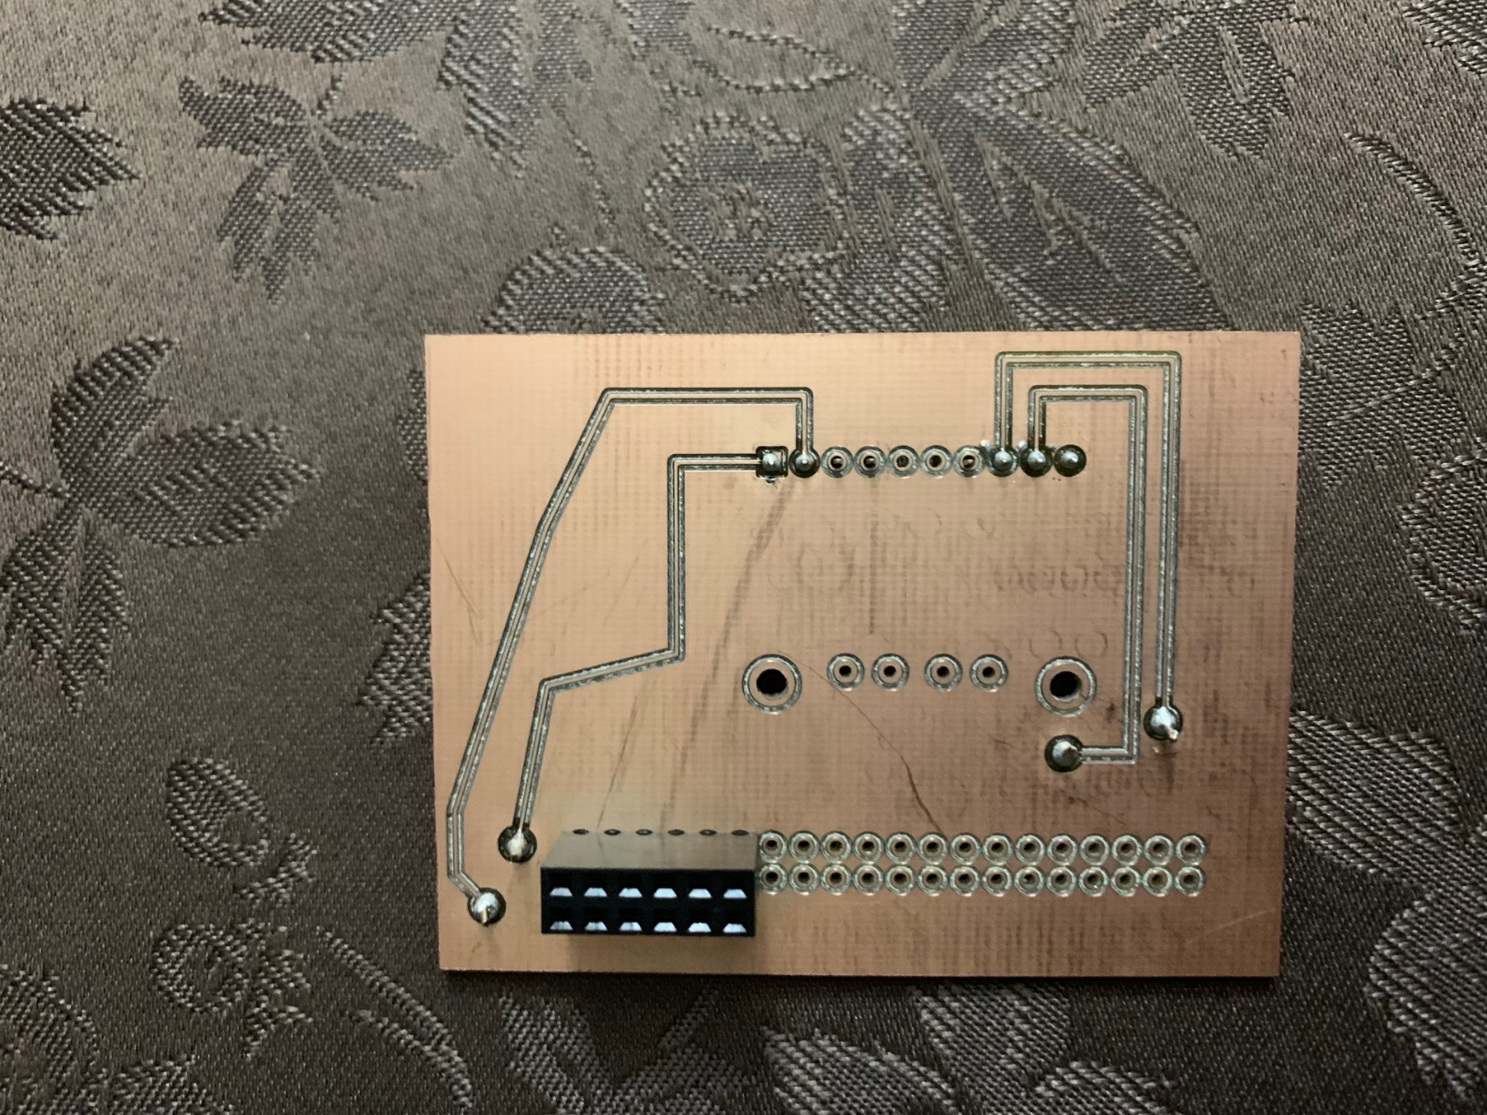
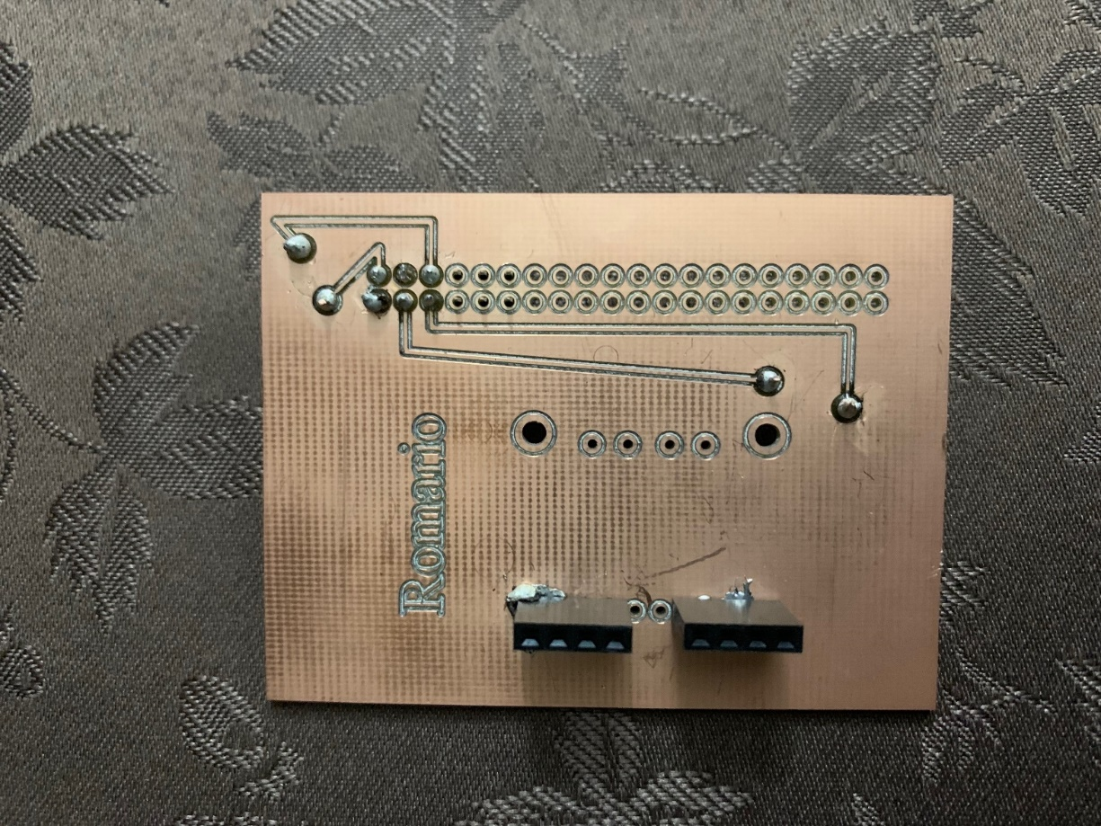
Printed Circuit Board - PCB

Slide 13
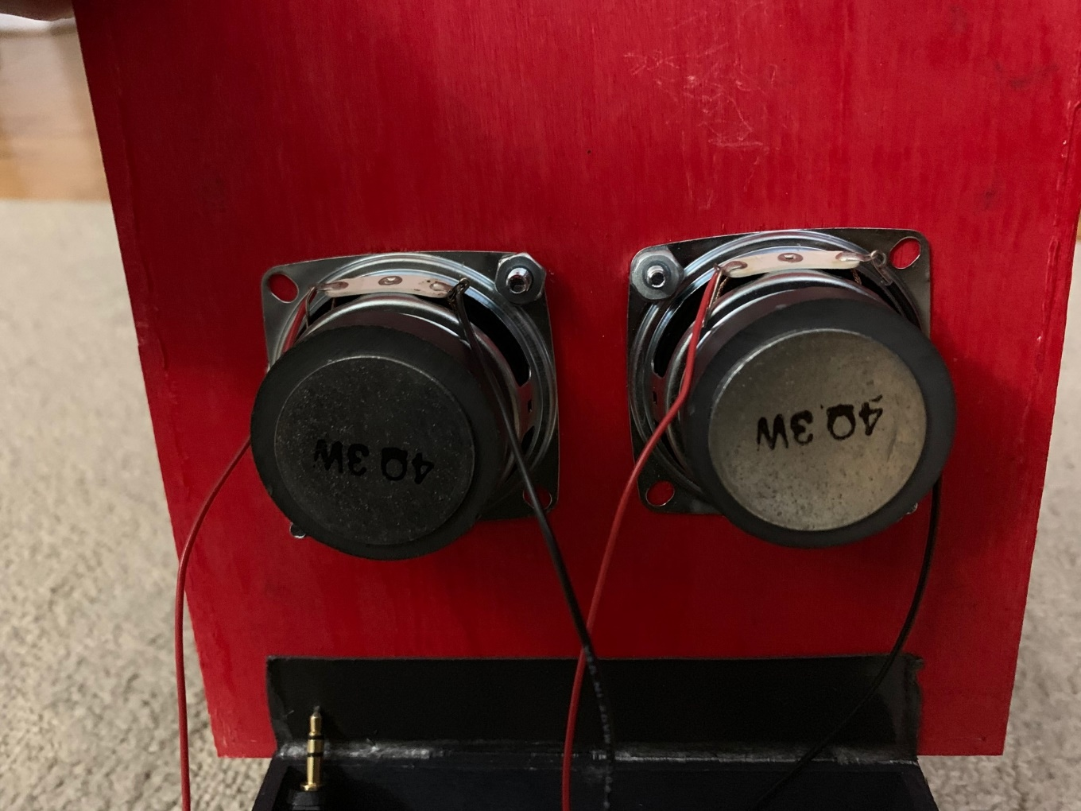
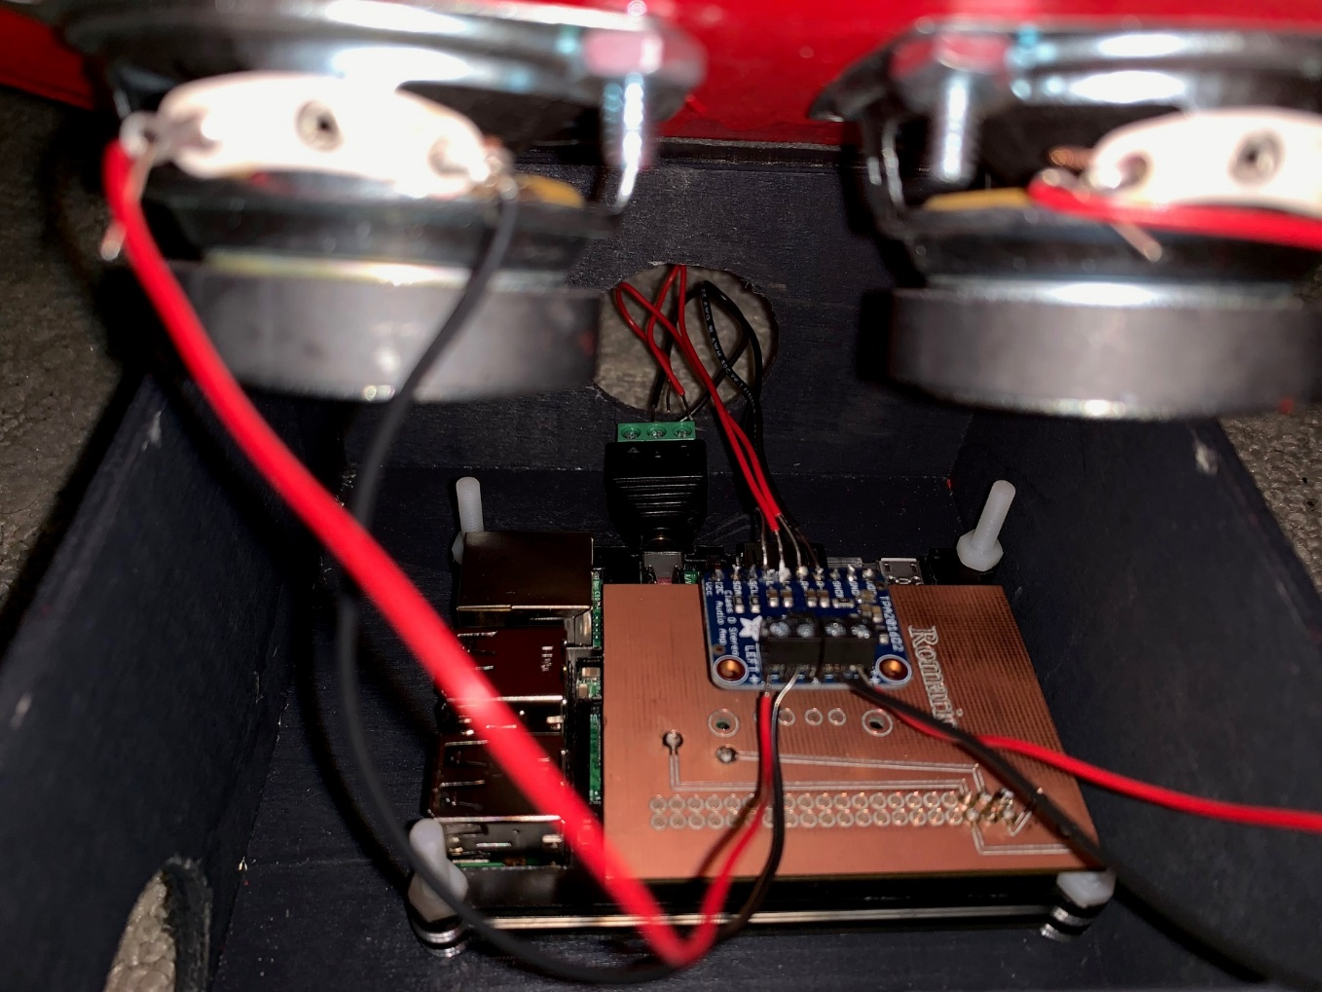
Mounting The Speakers

Slide 14
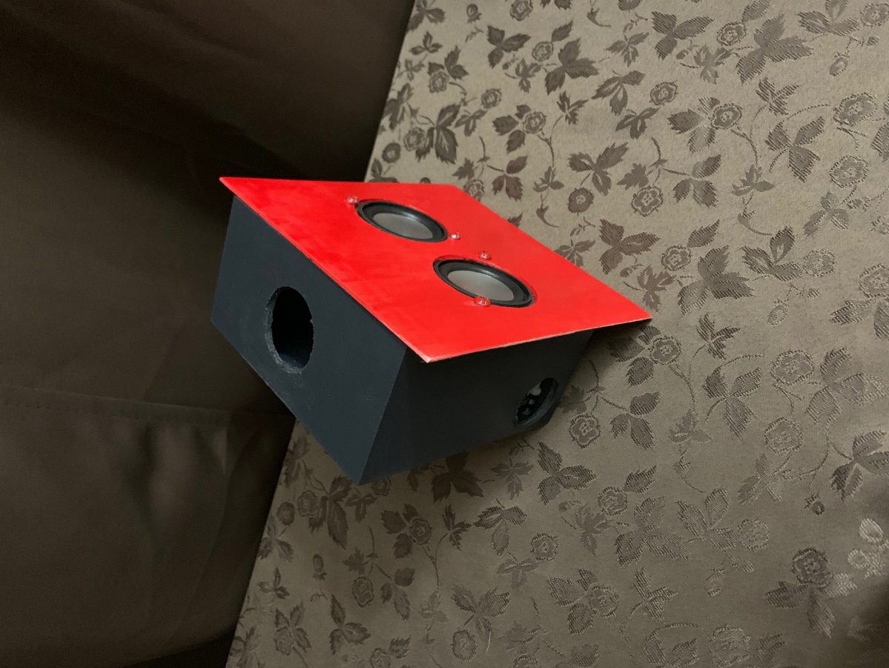
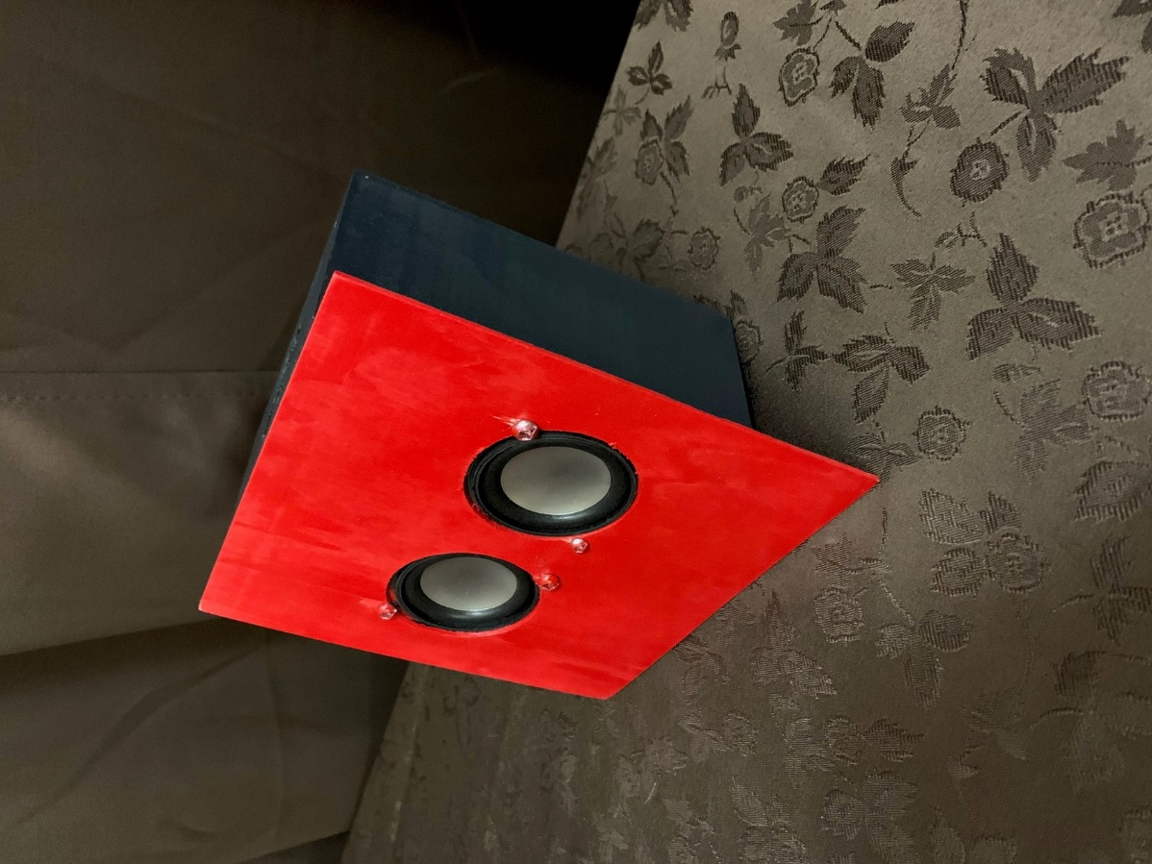
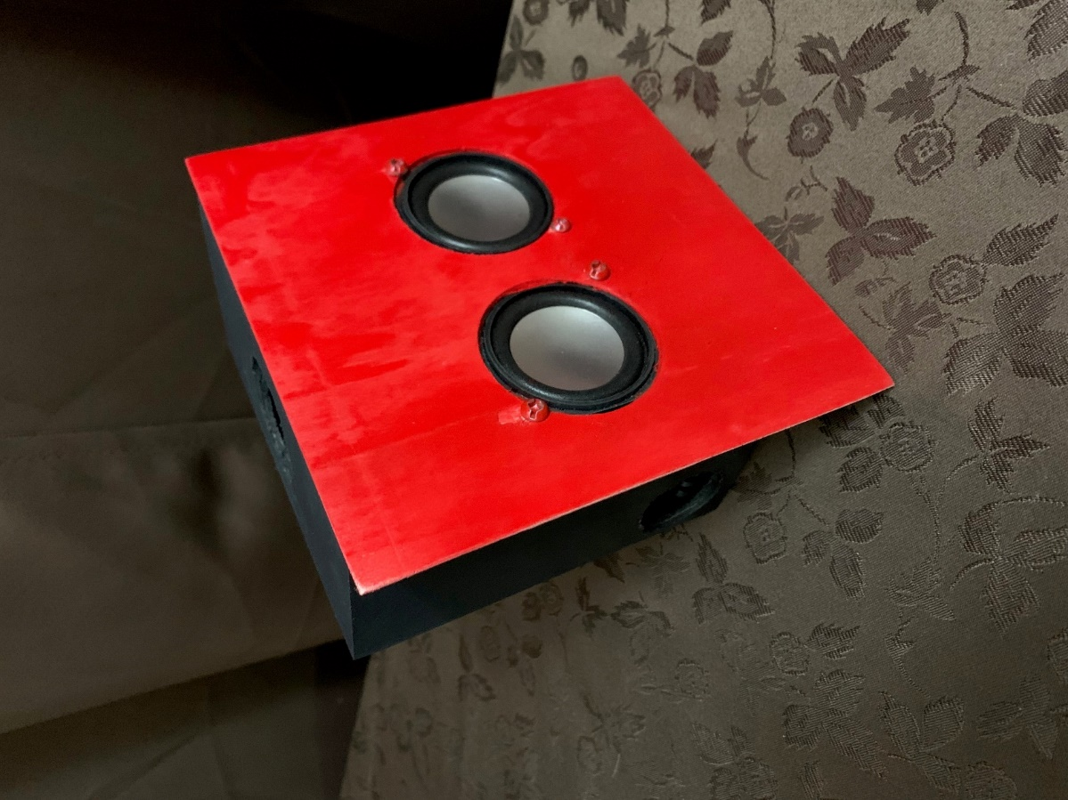
Final Setup

Slide 15
GitHub Link
https://github.com/RomarioT/CENG355

